Slide 1
COVID-19 Emission Data
DSI Hackathon
5/8/2020

Slide 2
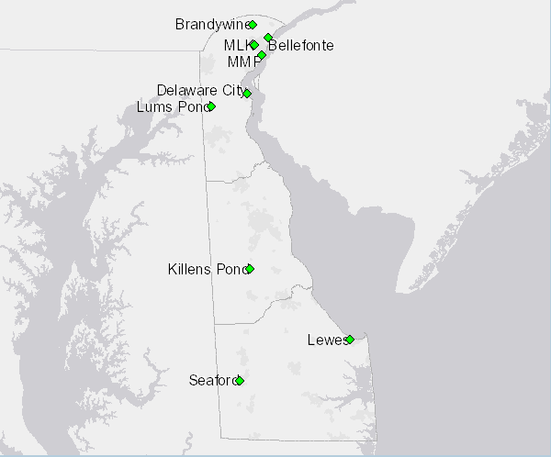
Delaware Air Quality Monitoring Network

Slide 3
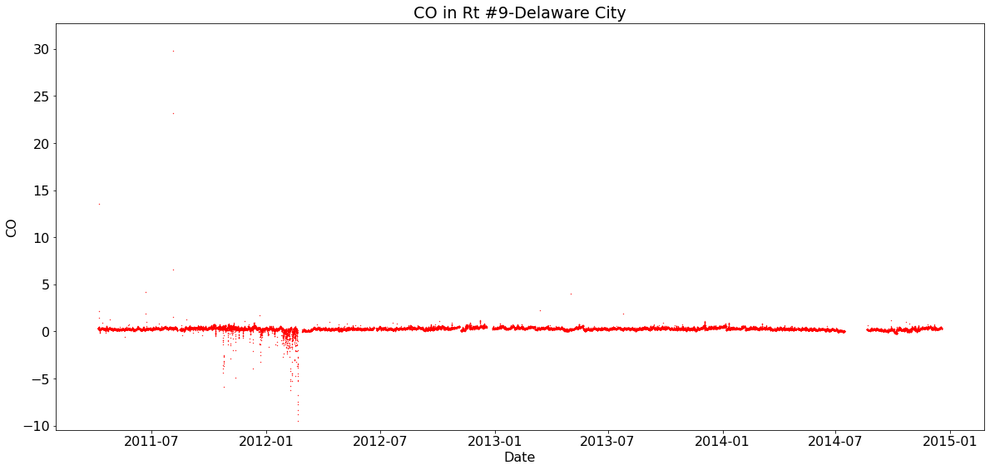
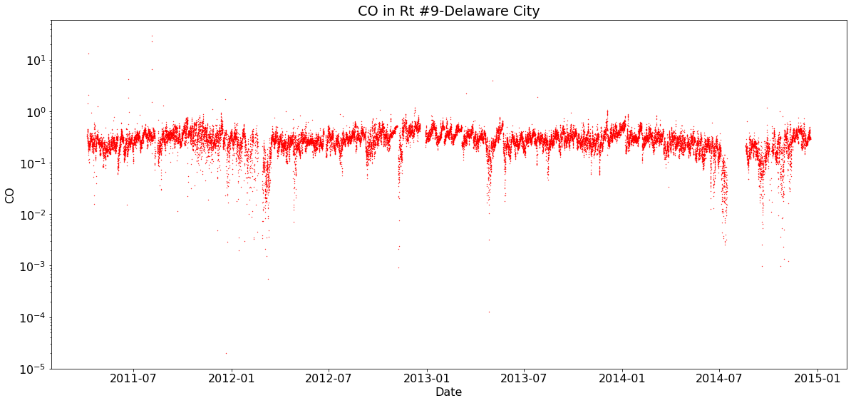
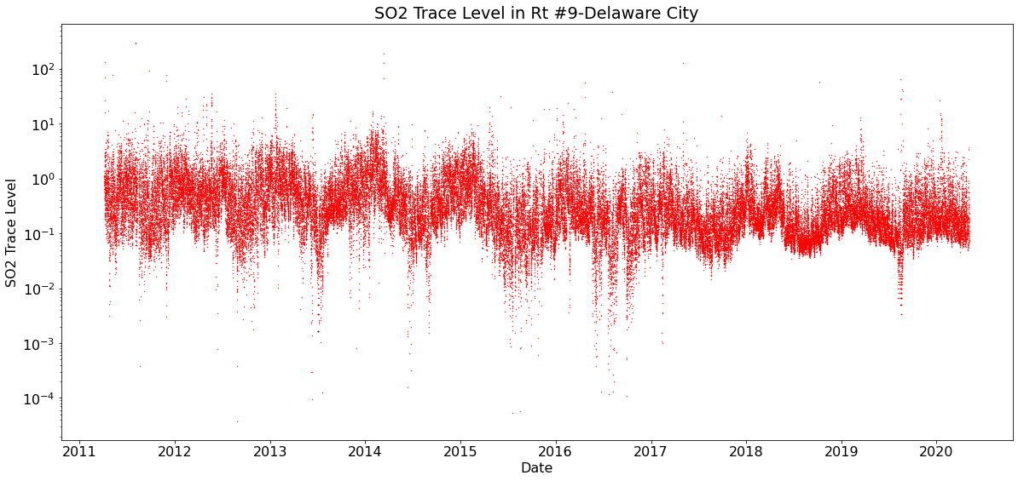
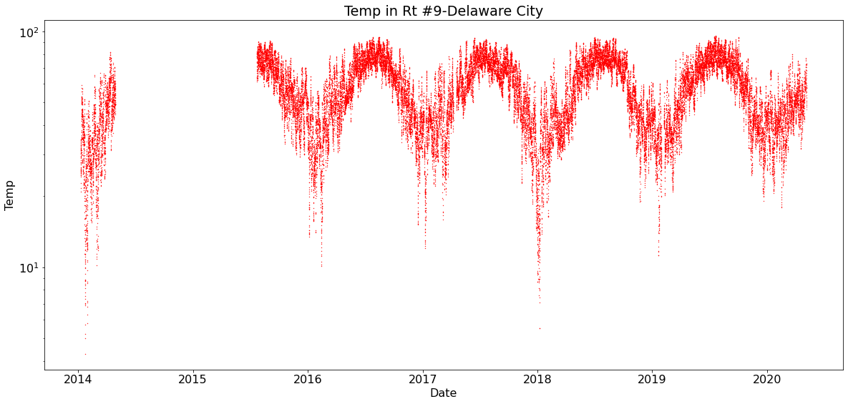
Data from the Delaware City station
Some variables have negative values that have to be discarded

Slide 4
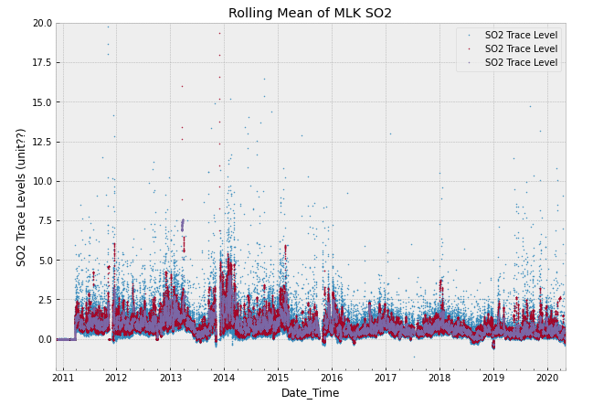
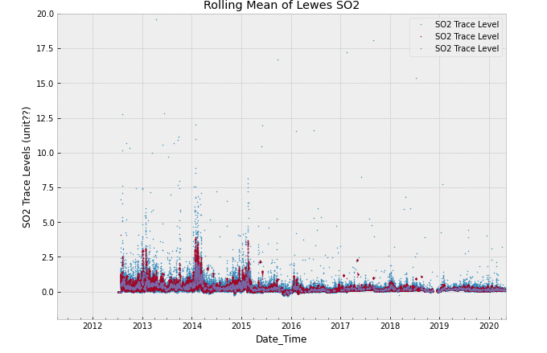
Rolling mean of SO2 for MLK and Lewes

Slide 5
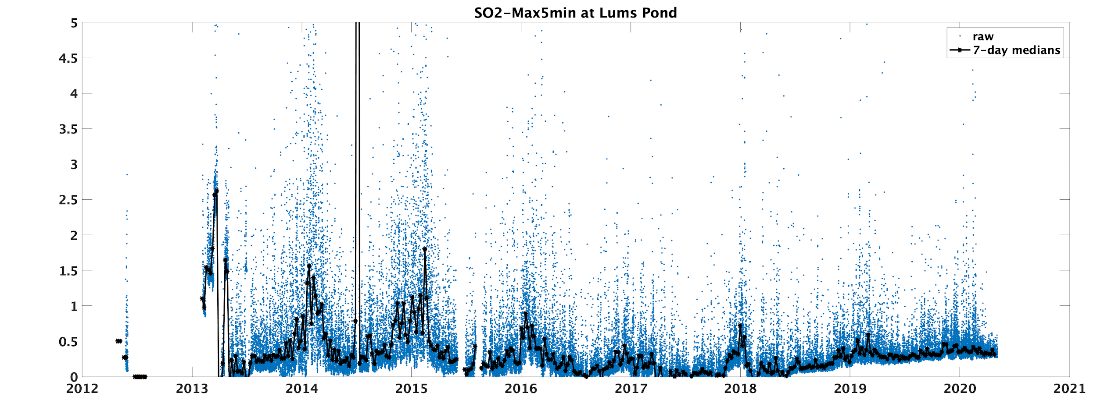
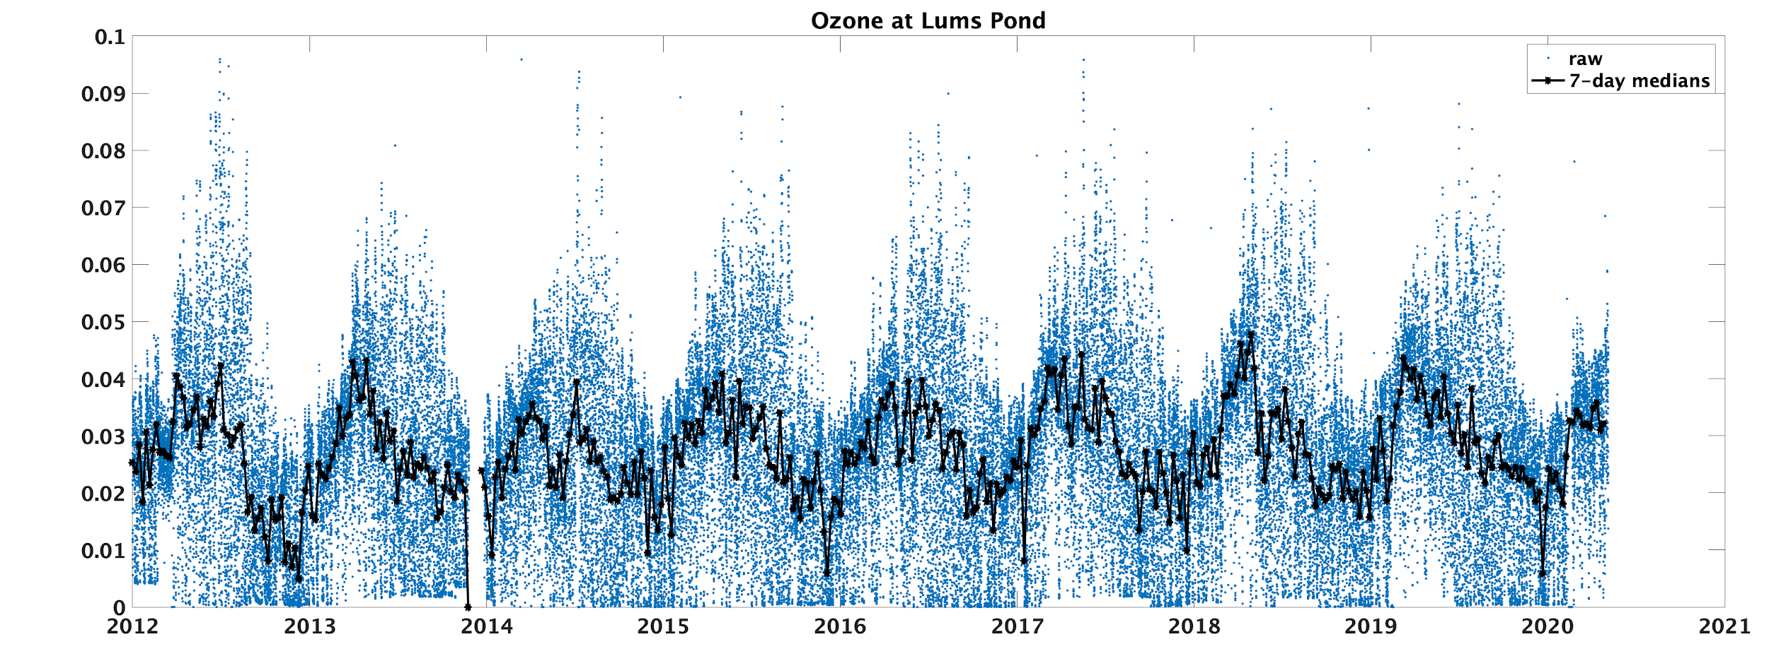
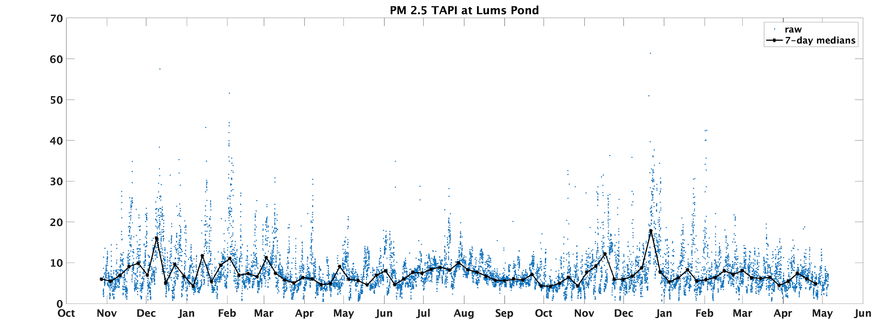
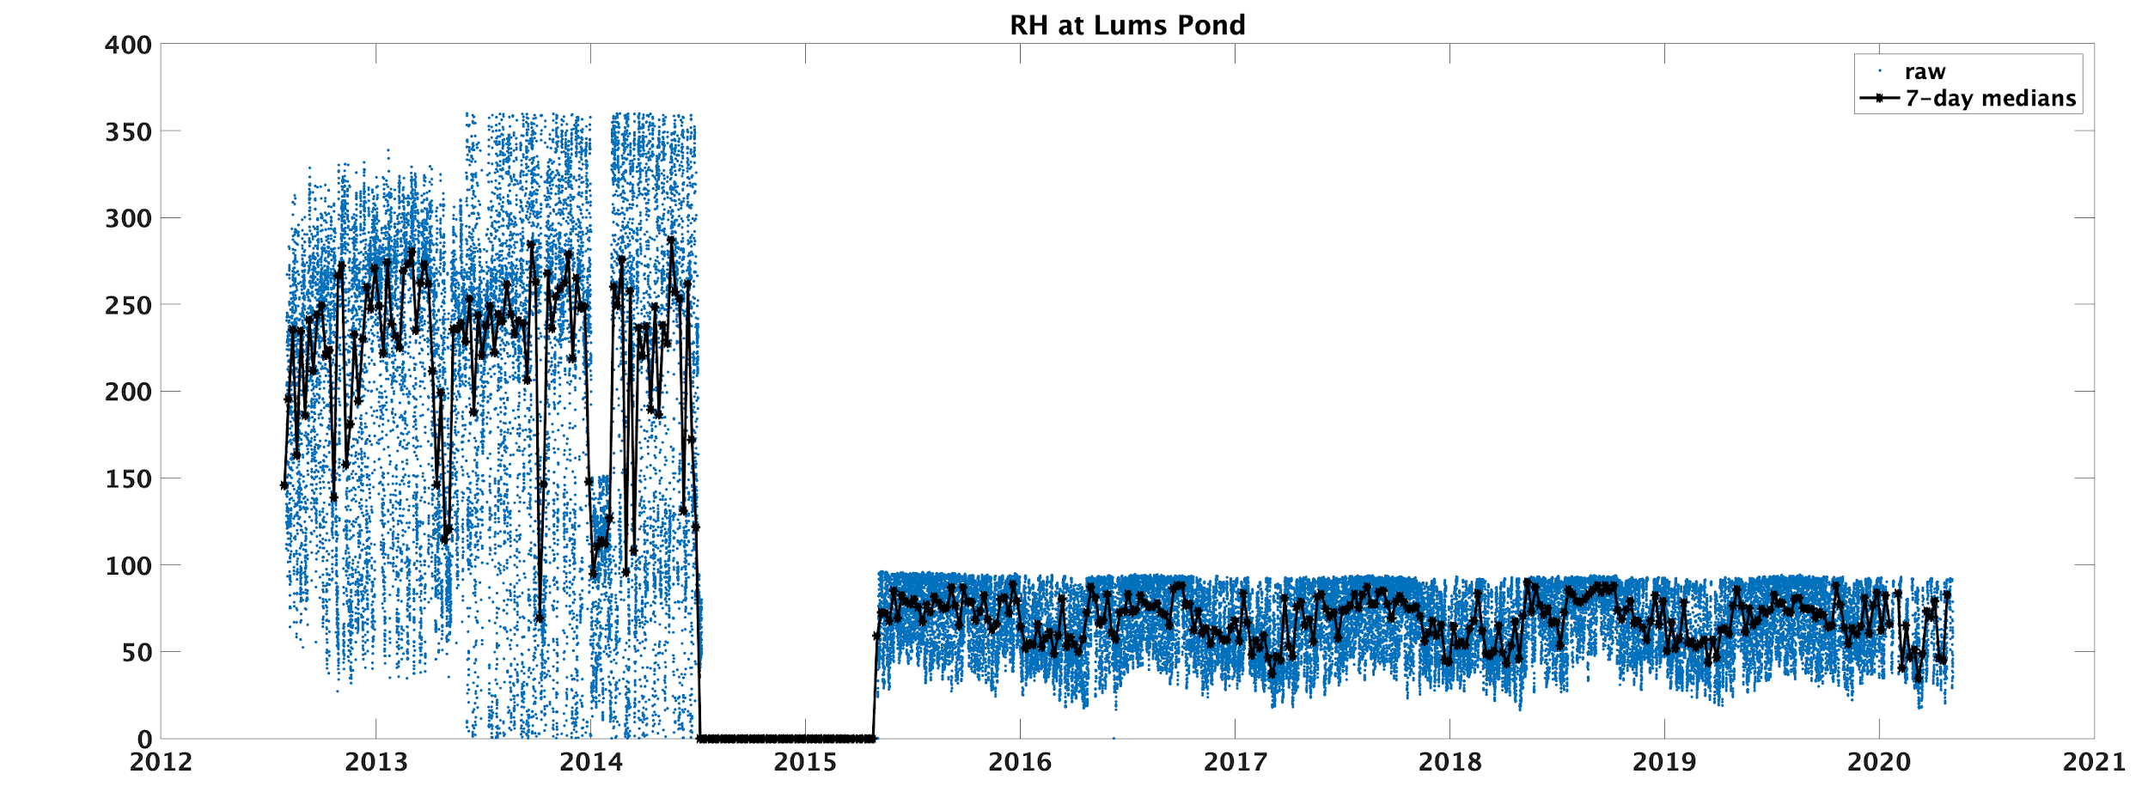
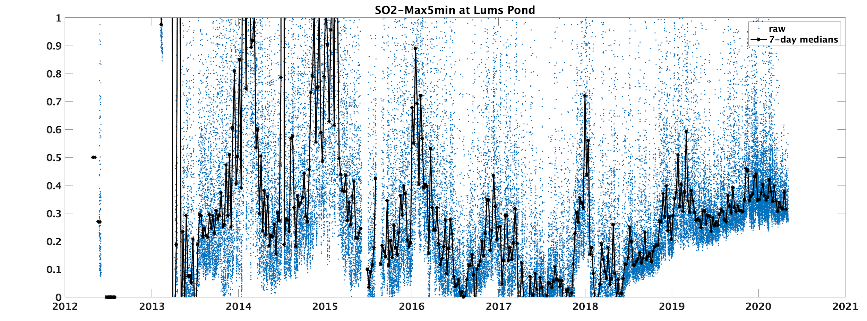
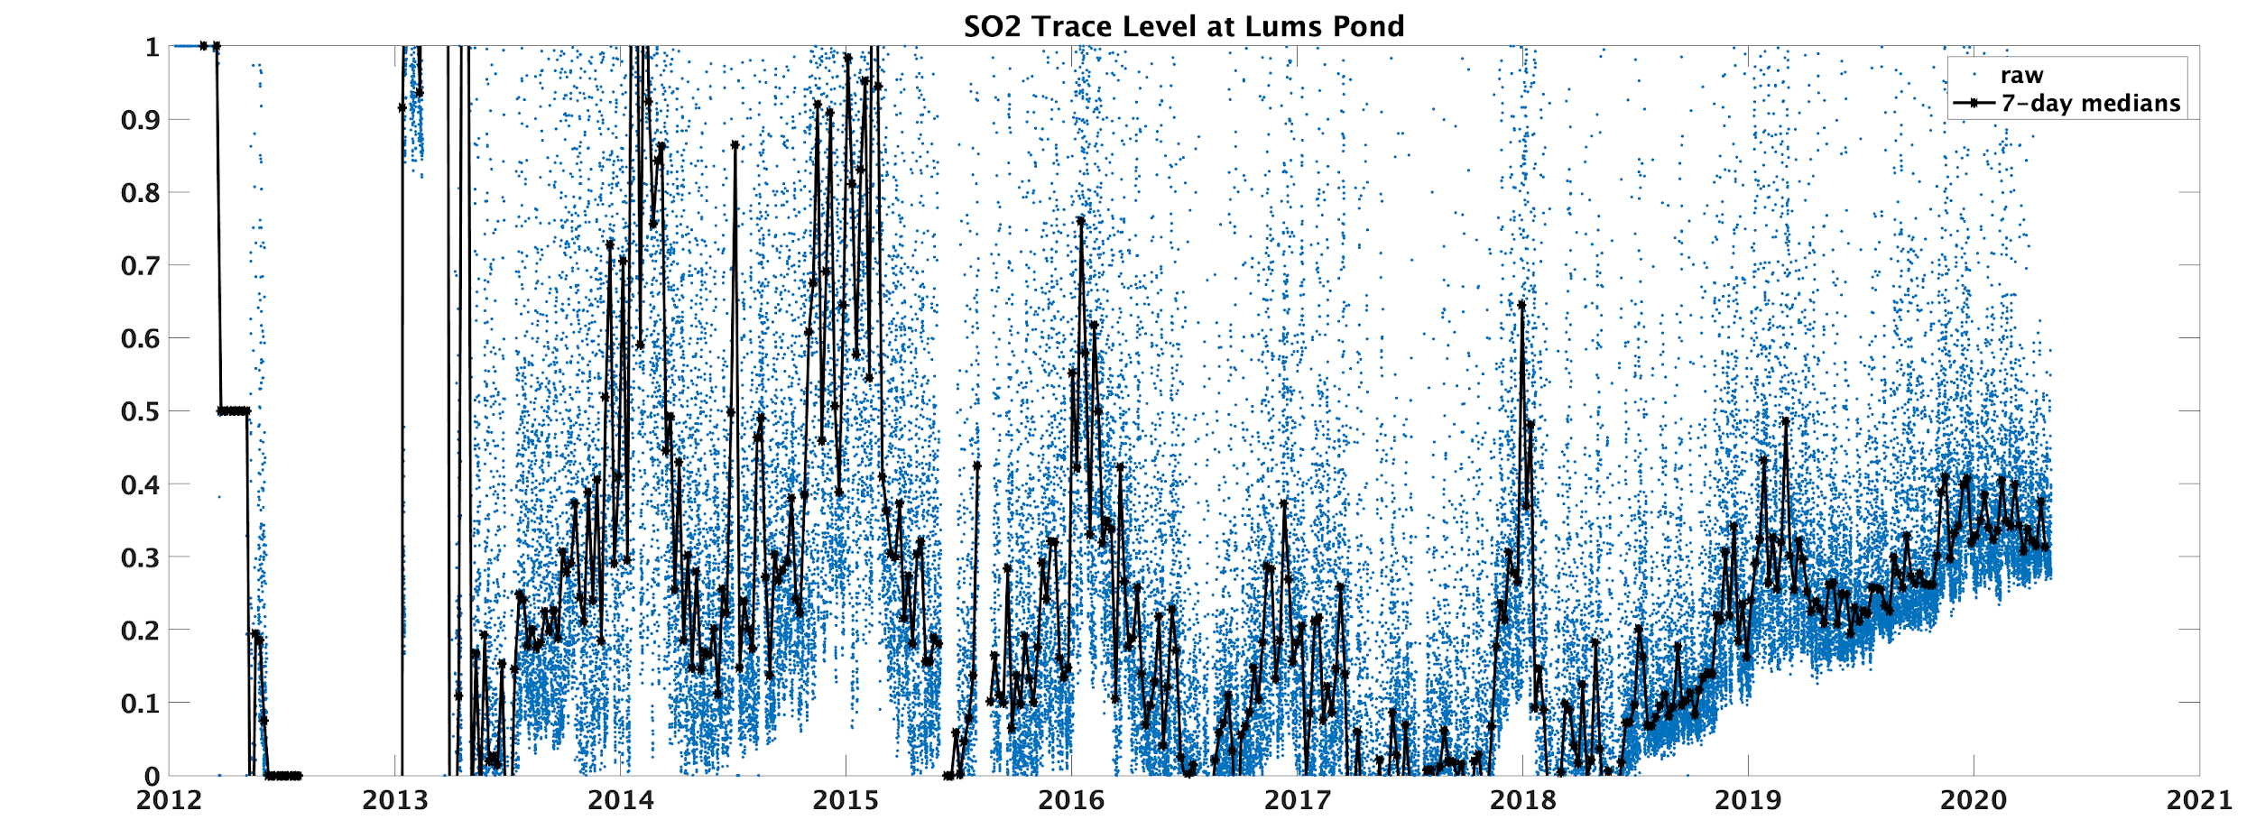
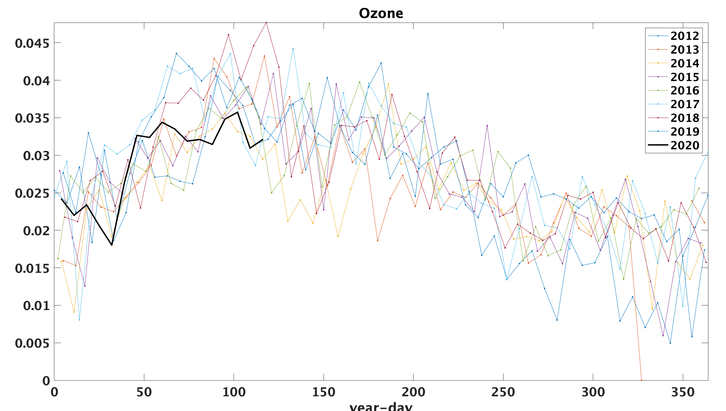
Lums Pond Data

Slide 6
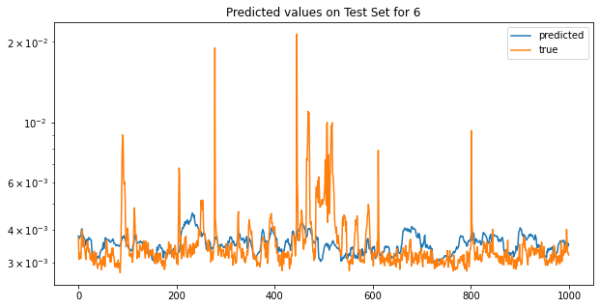
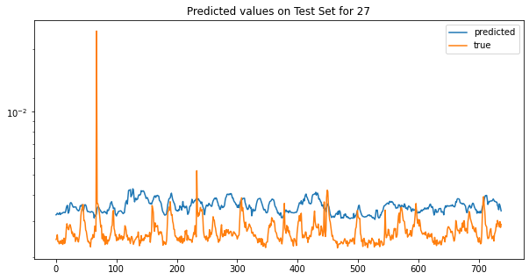
Predicted using Neural Network.
Data cadence: 1 sample/hour
Training set: 40,000 points
Validation set: 10,000 points
Test set: 15,000 points
2013-01-28 - 2013-03-11
2020-03-07 - 2020-05-07
Scaled SO₂ concentration (Lewes)

Slide 7
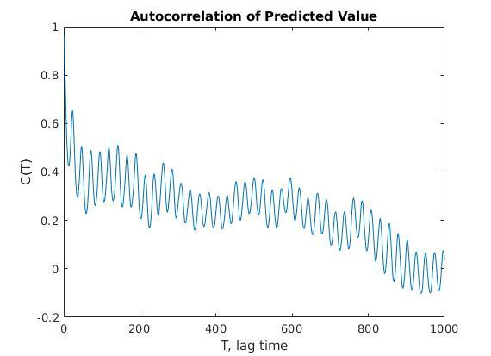
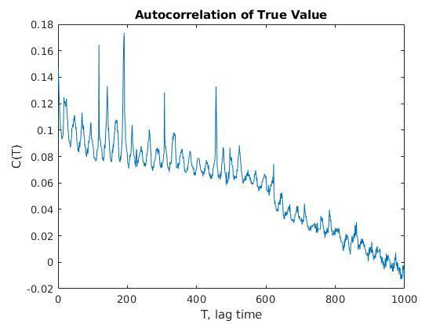
Autocorrelation of Neural Network trained on Data Set of Sulfur Dioxide Concentration per Hour in Lewes

